Slide 1
Secure Software Design – Assignment 2
Basic Secure Django Web Application
Aishwarya Selvarajan

Slide 2
About SecureX Web Application
SecureX Web application is implemented in Python’s web framework Django.
This application is developed with few basic secure web checklist.
A very basic web app with following Web Pages and functionality:
Admin Page: Default Page where Admin manages the Users
Home Page : Default Landing Page of the User
User Registration Page : Created with a very basic and required form fields Username, Email ID, Password 1, Password Confirmation and ReCaptcha.
Login Page : Page where the registered users can log in
Dashboard Page : Page where the User lands on successful Login
Two factor Authentication Page: Users can Enable/ Disable the two factor Authentication, Can have the backup tokens.
Account Lockout Page : Users redirected on # of failed attempts during Login
Logout : Users will be redirected to Home Page.

Slide 3
What is implemented?
Following functionalities are implemented in a secure way:
Certain Default security features of Admin Pages
Adding a reCAPTCHA in a User Registration Page
Implementing Two-Factor Authentication (2FA)
Adding a session timeout
Protection against brute force attacks
Creating environment variables
Configure and set various built-in security settings – Pre-Deployment Configurations

Slide 4
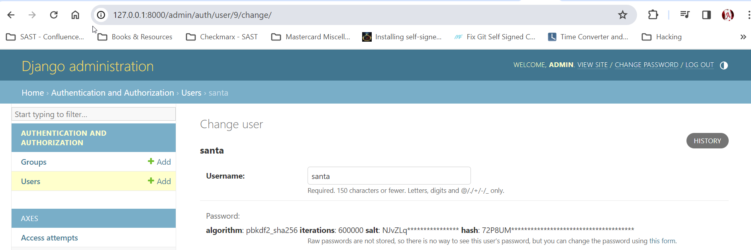
Security Feature of Admin Page
By default, Django uses a secure hashing mechanism, PBKDF2 algorithm with a SHA-256 hash.
Django uses a robust and secure password hashing mechanism to protect user passwords. This mechanism helps ensure that even if the database is compromised, attackers cannot easily retrieve users' plaintext passwords. Django's password hashing mechanism consists of PBKDF2.
PBKDF2 is a simple cryptographic key derivation function that is resistant to dictionary attacks.

Slide 5
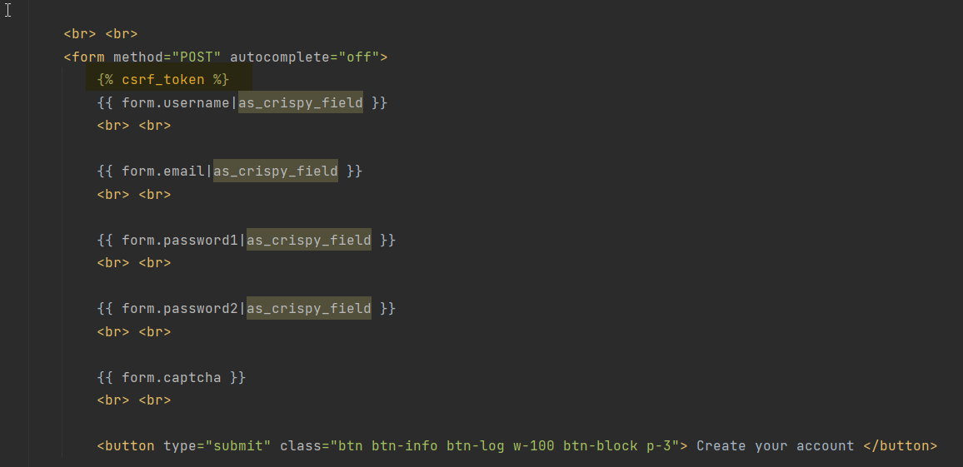
CSRF Protection
The CSRF middleware in Django and template tag provides easy-to-use protection against CSRF. Cross-site request forgery (also known as CSRF) is a web security vulnerability that allows an attacker to induce users to perform actions that they do not intend to perform. In a successful CSRF attack, the attacker causes the victim user to carry out an action unintentionally.

Slide 6
2 Factor Authentication
Two-Factor Authentication or ‘2FA’ is an extra layer of security that is added in conjunction with a username and password
Usually, it is in the form of a physical or virtual device -(phone)
Google Authenticator app is used to implement 2 factor where a random token is generated every 30 seconds which is used to Login to the account.
Django-two-factor-auth package was used to implement 2 Factor authentication.
Reference:
https://django-two-factor-auth.readthedocs.io/en/stable/installation.html

Slide 7
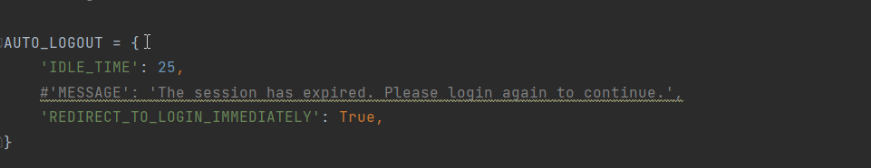
Session Timeout
Users often forget to log out of their accounts, hence leaving their account idle for several hours
If they forget to logout in a public environment, anyone can simply use their computer and make devastating changes
Therefore, users should be logged out automatically if they remain idle for too long.
django-auto-logout package is used to implement this.
For this app the Idle time is set to 25 seconds. So if the user is not active for 25 seconds it will automatically logged out.
Reference:
https://pypi.org/project/django-auto-logout/

Slide 8
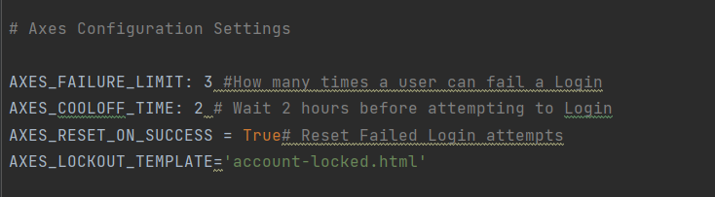
Preventing Brute forcing:
A ‘brute-force’ attack is when another user attempts to login to your account by trying out multiple username and password combinations in the hope of guessing correctly
These attackers use a ‘trial-and-error’ method.
Created an account lockout page
Django axes packages are used to implement prevention of Brute force attacks.
Following is the screenshot of the implementation
Reference:
https://pypi.org/project/django-axes/

Slide 9
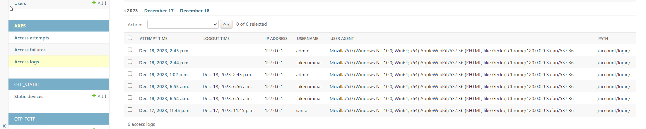
Preventing Brute forcing Contd.,
One another advantage of using axes package is admin will be able to see the Access logs. So, the failed attempts of any user (which could be malicious) can be alerted to admin.

Slide 10
Secure Session Management – Pre Deployment Configurations
To prevent the attackers from stealing user’s session cookies on HTTP connection parameter SESSION_COOKIE_SECURE is set to True in settings.py. This makes the browser send cookies only through secure HTTPS connection.
To prevent the client side Javascript from accessing the user’s cookies SESSION_COOKIE_HTTPONLY is set to True. This also mitigates the XSS risk.
Secure Parameters related to HSTS Headers:
HSTS Response header informs browsers that the site should be accessed only using HTTPS and that any future attempts to access it using HTTP should be automatically be converted to HTTPS. Following parameters related to HSTS headers are set.
SECURE_HSTS_SECONDS = 86400 SECURE_HSTS_INCLUDE_SUBDOMAINS = True

Slide 11
Major References for Implementation of this Project
https://www.udemy.com/course/python-django-ultimate-web-security-checklist-2022/learn/lecture/34158588#overview
https://docs.djangoproject.com/
https://portswigger.net/web-security/all-topics

